Slide 1
Automated Package Separator
Advanced Mechatronics ROB-GY6103
Spring 2024
Term Project -1
By:
Shantanu Ghodgaonkar - N11344563
Mihir Kshirsagar - N16144406
Hemant Agrawal - N10037896
Aditya Abishai - N15101231

Slide 2
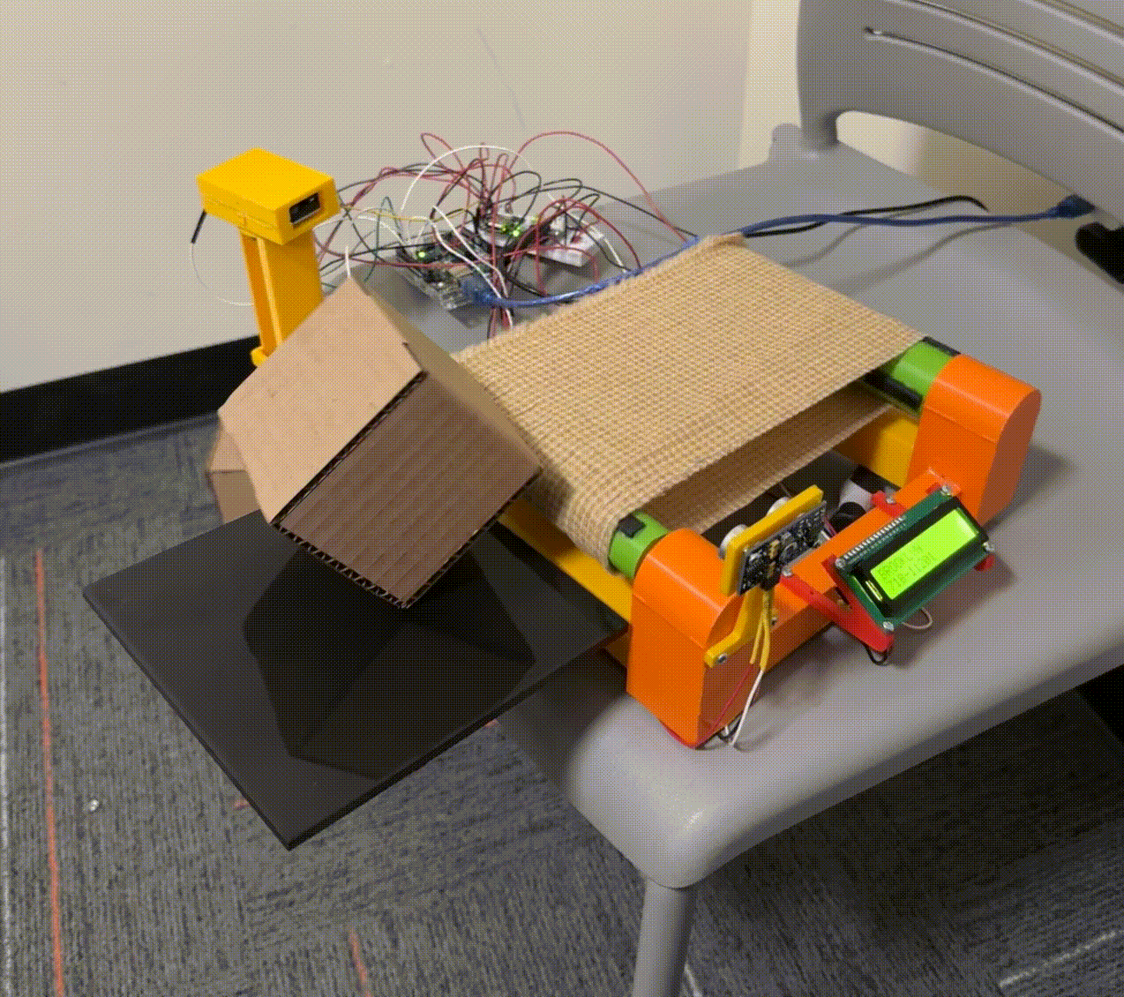
Objective
To create an automated package separator that demonstrates Mechatronics by synchronising an Arduino with motors, sensors and a tilting mechanism to segregate packages based on location codes.

Slide 3
Components
Arduino Uno
Waveshare 1D/2D Barcode scanner
Servo motors - MG996R
DC motor & Relay
Parallax PING)))
Parallax 2x16 LCD serial display module
Conveyor System

Slide 4
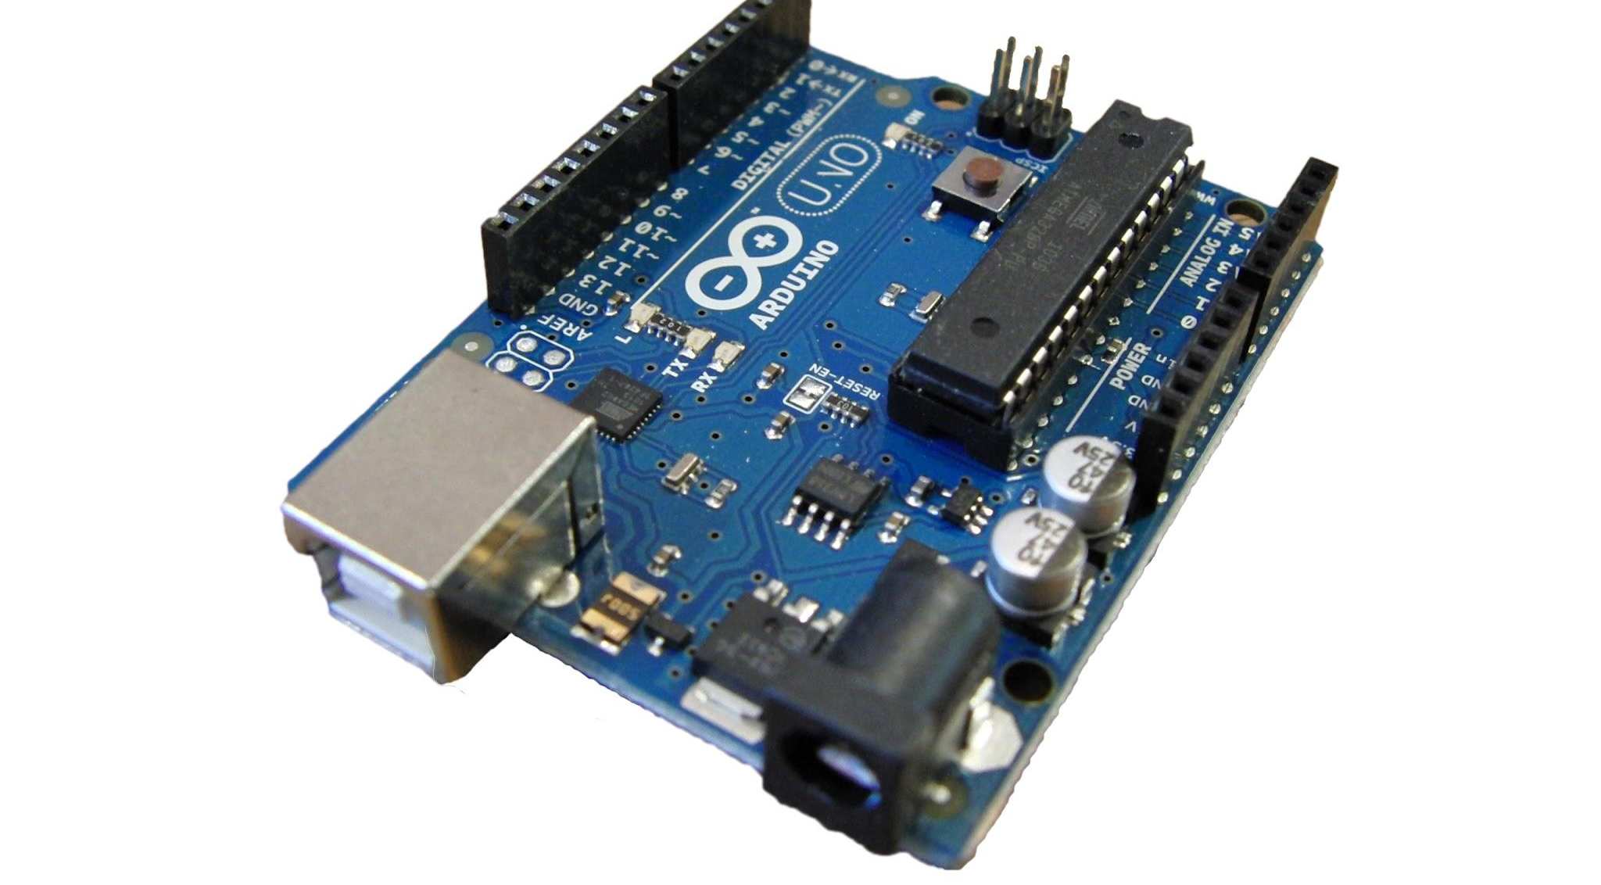
Arduino Uno
The Arduino Uno is a versatile development board powered by the ATmega328P microprocessor, offering a range of features for connecting sensors and actuators in various projects.
Microprocessor: ATmega328P
14 digital I/O pins
6 analog pins
Communication protocols: SPI, I2C, USART, TWI
32kb flash memory
Compact size and user-friendly
Ideal for hobby projects and suitable for various tasks

Slide 5
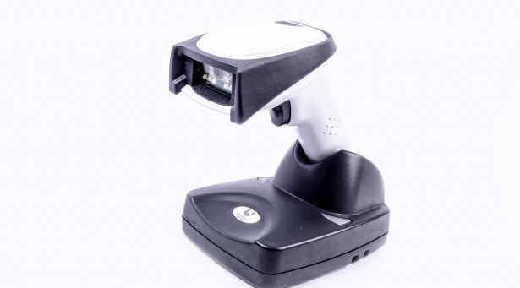
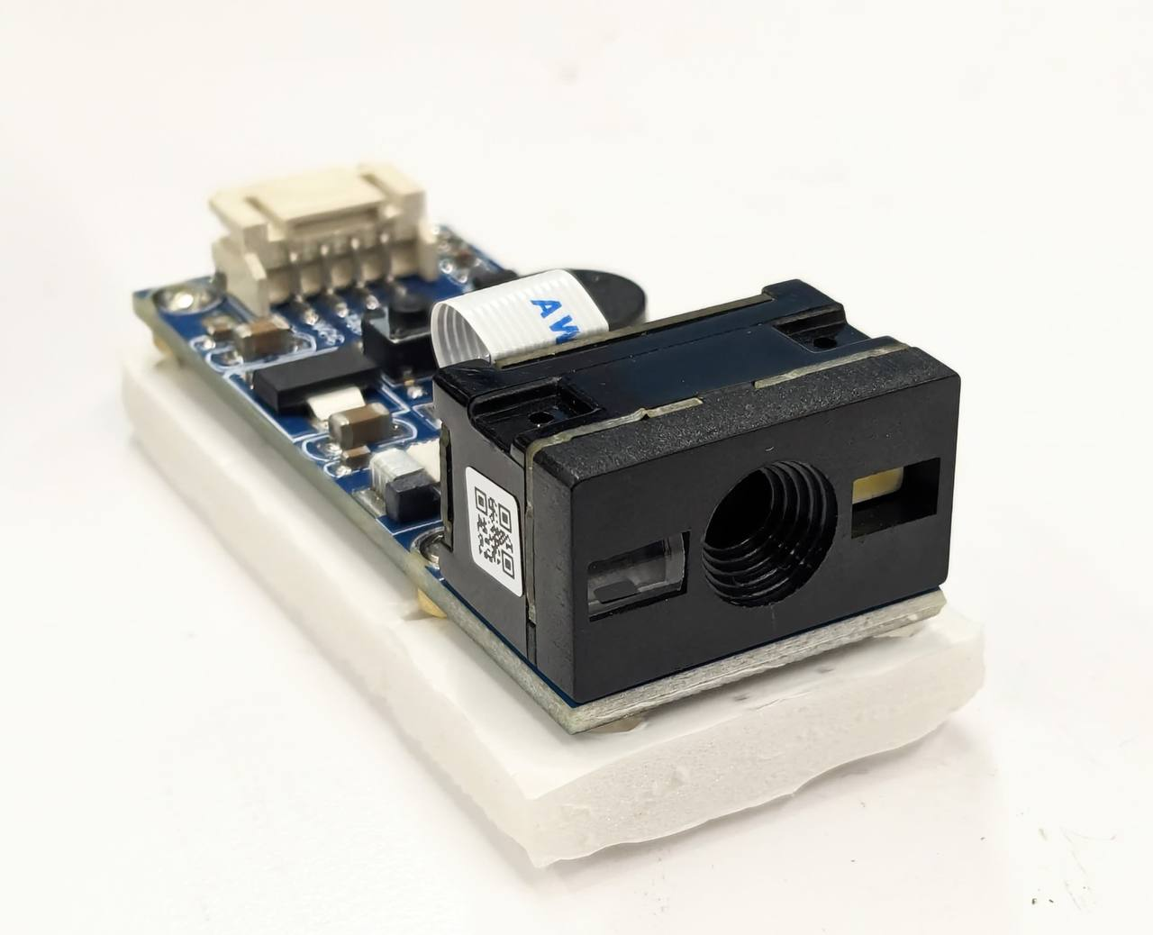
Waveshare 1D/2D Barcode Scanner
A barcode scanner is a electronic device designed to read and interpret barcode information swiftly and accurately.
Types of Barcode Scanners:
1D Barcode Scanners: Decode linear barcodes commonly found on retail products.
2D Barcode Scanners: Decode two-dimensional barcodes, capable of storing more data and often used in logistics and healthcare.
Waveshare Barcode Scanner Module features and specifications:
Decodes various common 1D/2D codes
Onboard micro USB and UART serial port, allows to connect with computers or embedded devices
Configurable via scanning 'configuration code'
Onboard light source, works in the dark
5V~125mA operating power

Slide 6
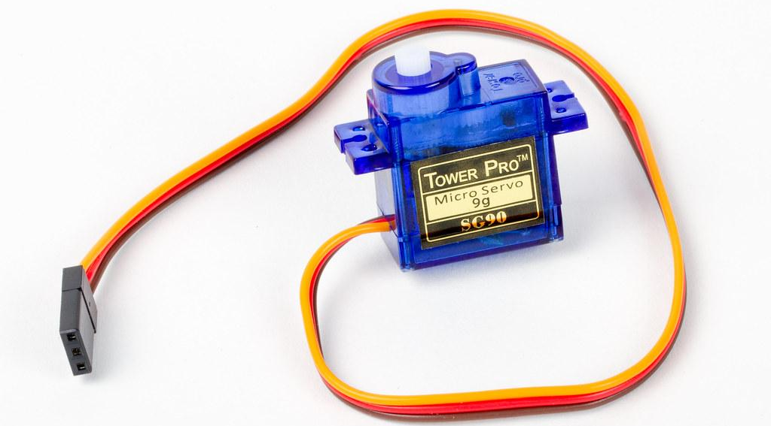
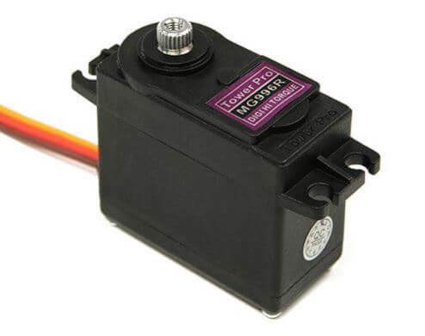
Tower Pro MG996R Servo Motor
Servo motors are actuators that provide precise control over the position, speed, and acceleration of a mechanical component.
MG996R Features and Specifications:
Stall torque: 9.4 kgf·cm (4.8 V ), 11 kgf·cm (6 V)
Operating speed: 0.17 s/60º (4.8 V), 0.14 s/60º (6 V)
4.8V - 7.2V ~ 500mA - 900mA operating power
Stable and shock proof double ball bearing design
Temperature range: 0 ºC – 55 ºC

Slide 7
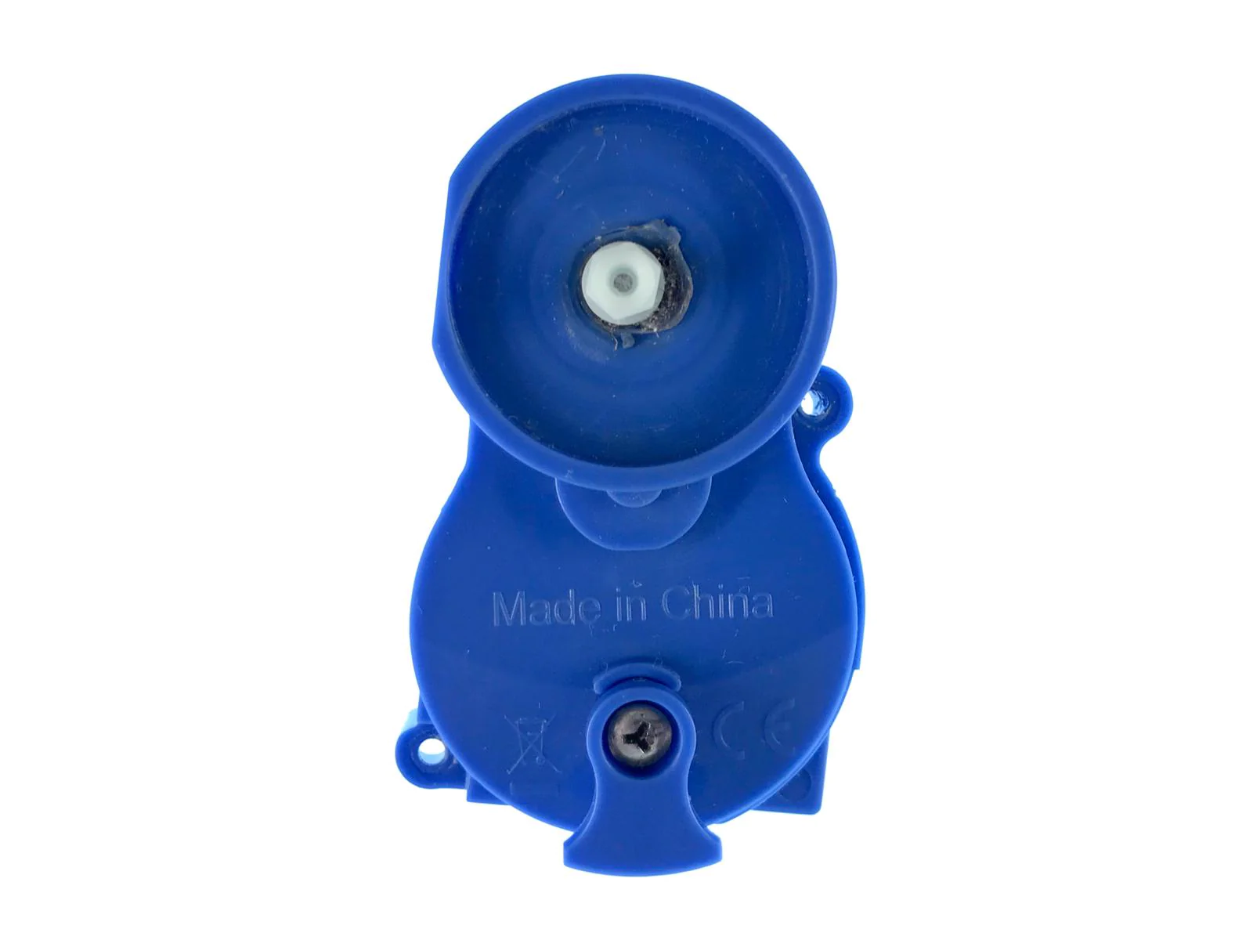
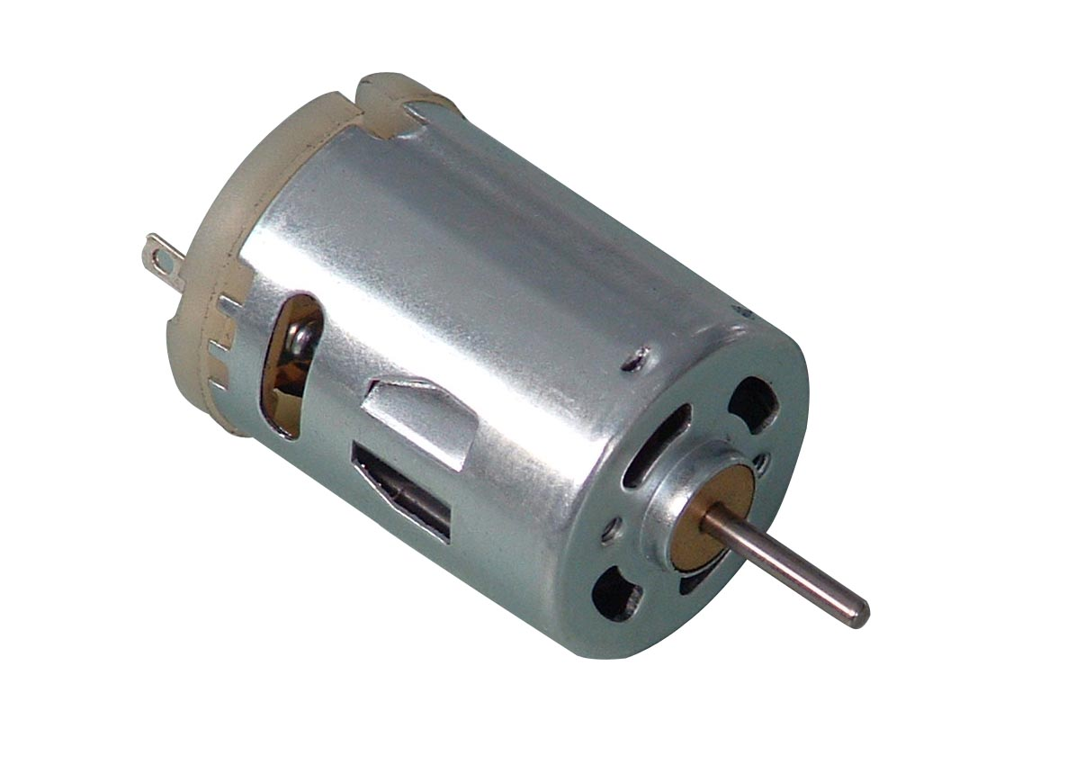
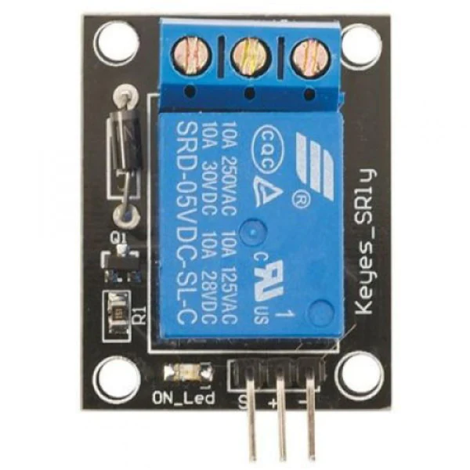
DC Motor and Relay
A DC motor converts direct current (DC) electrical energy into rotational mechanical energy.
A relay is an electrically operated switch that uses a small current to control a larger current.
DC Motor Features and Specifications:
3.3V~120mA Operated Power (Upto 14V)
SRD-05VDC-SL-C Features and Specifications:
Switching capacity available by 10A in spite of small size design for high density P.C. board mounting technique.
Selection of plastic material for high temperature and better chemical solution performance.
Simple relay magnetic circuit to meet low cost of mass production
Rating: 7A/240VDC, 10A/250VDC, 10A/125VAC 28VDC, 10A/240VAC 28VDC
5V Operating Voltage

Slide 8
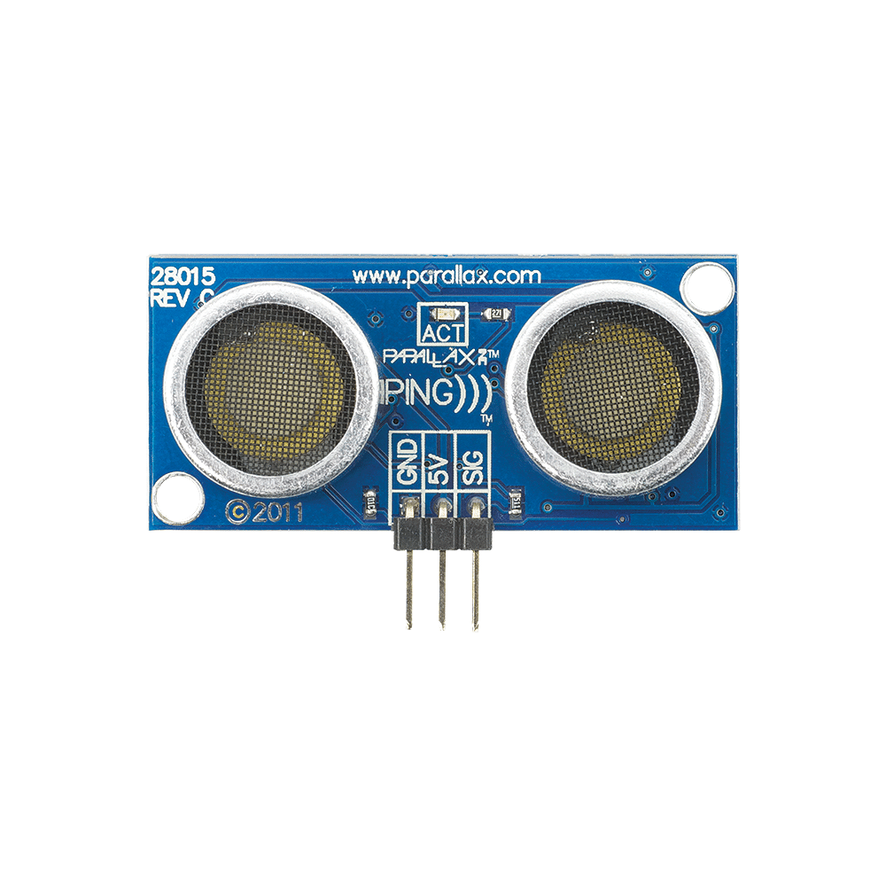
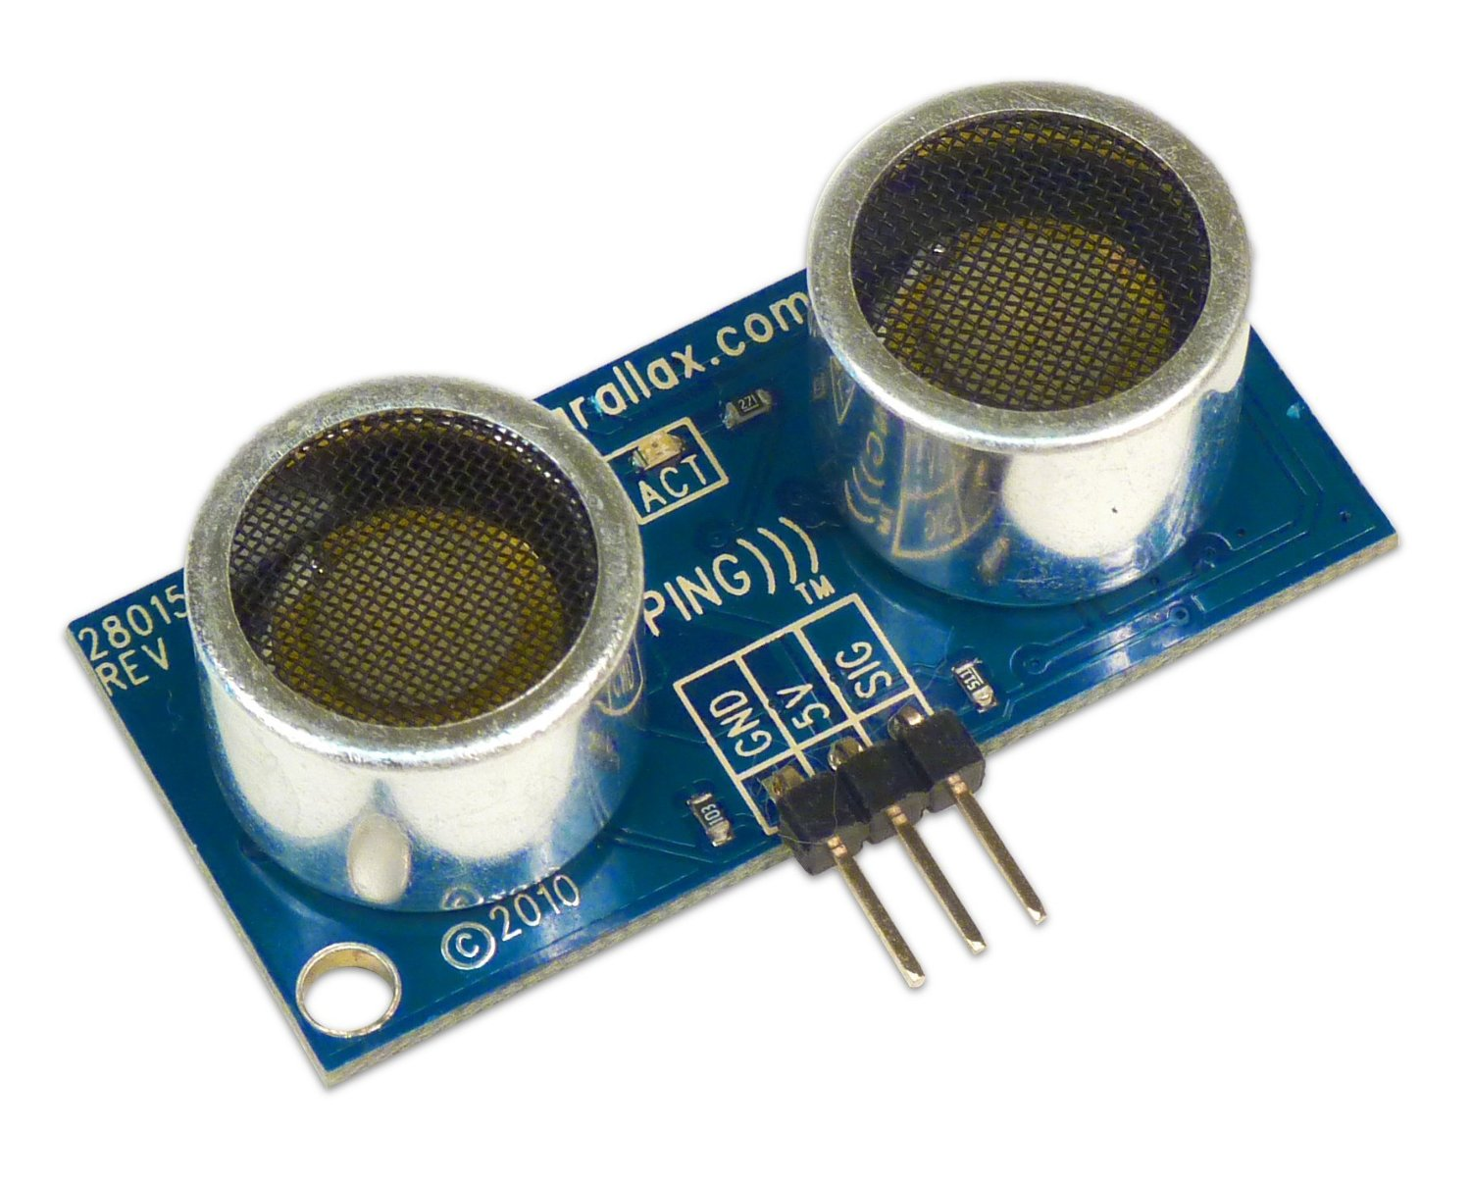
Parallax PING)))
The Parallax PING))) Ultrasonic Sensor is a popular ultrasonic range finder used in robotics and automation applications. It utilizes ultrasonic sound waves to measure distances and is commonly employed for object detection, navigation, and avoidance in various projects.
Features and Specifications:
Range: 2 cm to 3 m
Bidirectional TTL pulse interface on a single I/O pin can communicate with 5 V TTL or 3.3 V CMOS microcontrollers
Input trigger: positive TTL pulse, 2 µs min, 5 µs typ.
Echo pulse: positive TTL pulse, 115 µs minimum to 18.5 ms maximum
5V ~ 30mA operating power

Slide 9
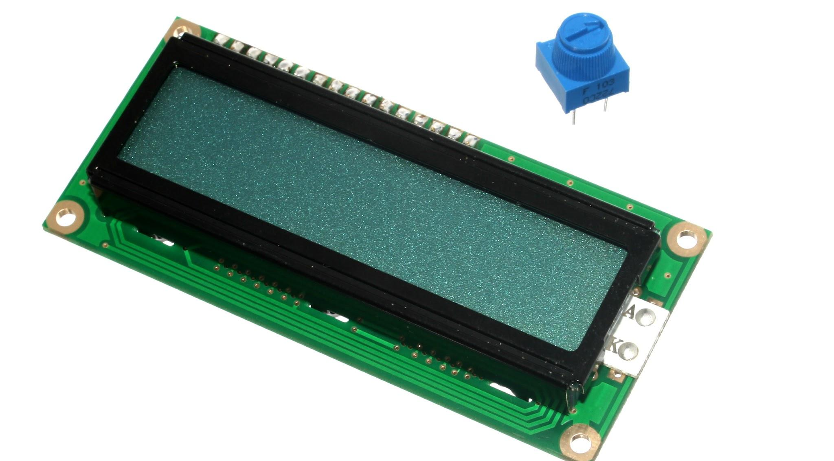
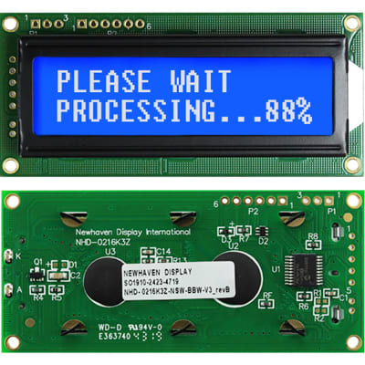
Parallax 2x16 LCD serial display module
An LCD (Liquid Crystal Display) module is a versatile electronic visual display that is commonly used to provide real-time information in various devices.
Parallax Serial LCD features and specifications:
Clear 40-pixel characters (8 H x 5 W)
Supports ASCII DEC characters 32-127
Automatic text wrapping
Single command clears the display
Select 2400, 9600, or 19,200 baud with switches on the device Adjustable contrast knob on the back of the device
5V~20 mA (light off), 5V~ 80mA (light on) operating power

Slide 10
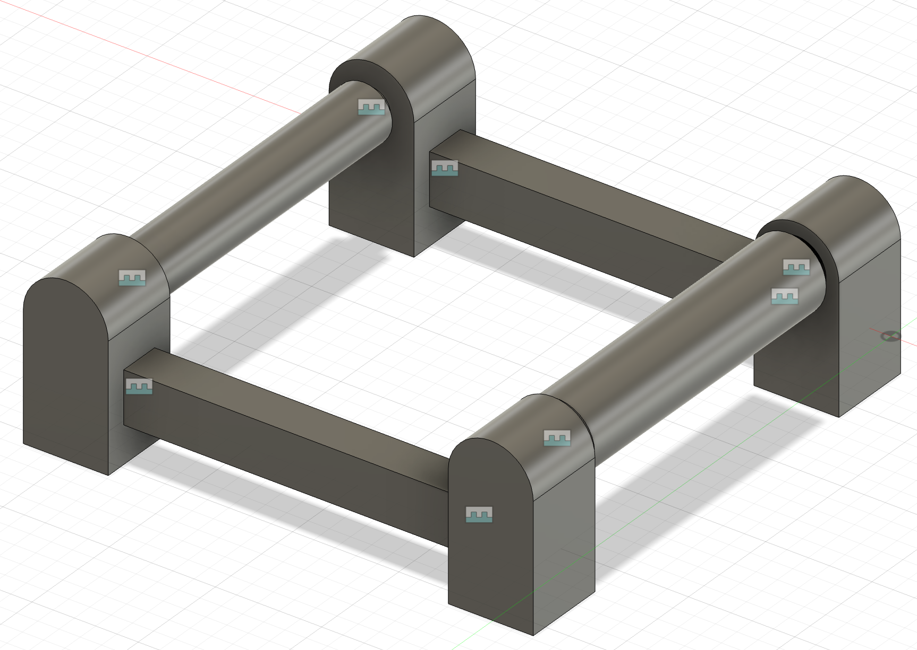
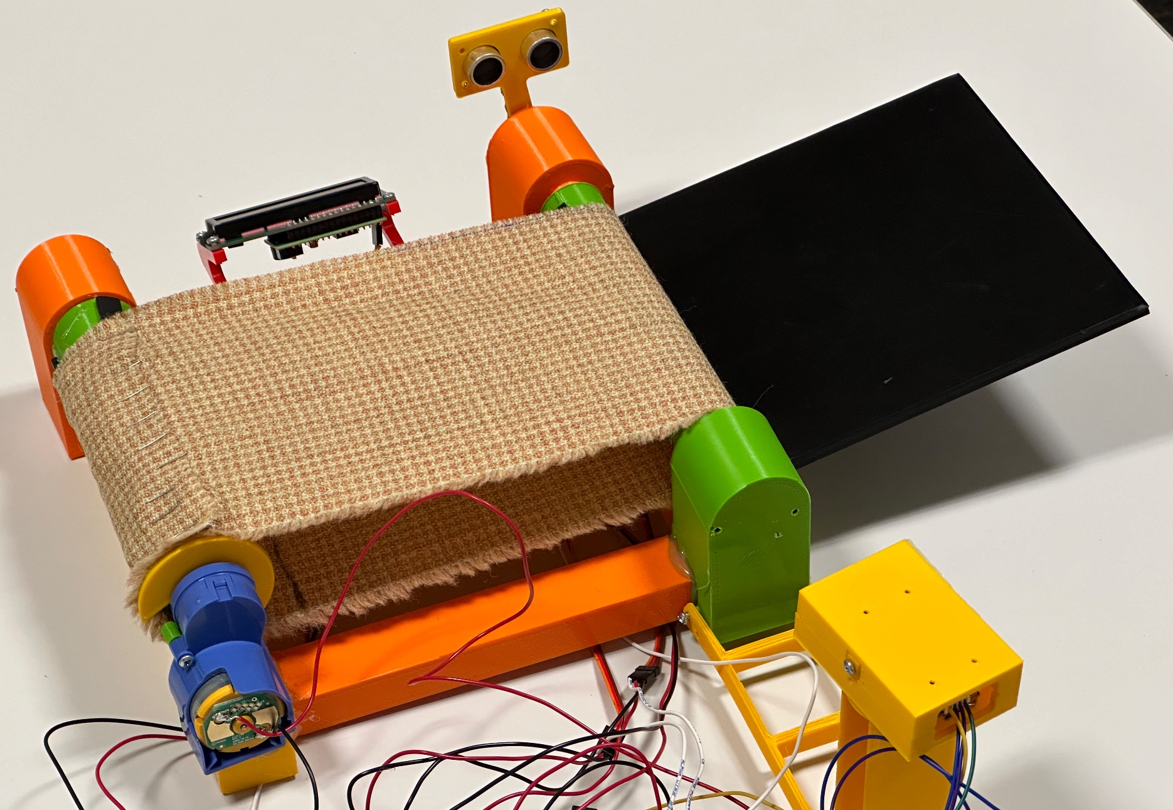
Conveyor System
Conveyor System is a mechanical handling equipment that moves materials from one location to another.
Conveyor System & Addons:
DC Motor runs driver shaft using key
PING))) Ultrasonic Sensor mount
Waveshare 1D/2D Barcode Scanner mount
LCD mount
Servo motor bracket
Cloth based belt drives driven shaft
2 Axis Tilt-table mechanism

Slide 11

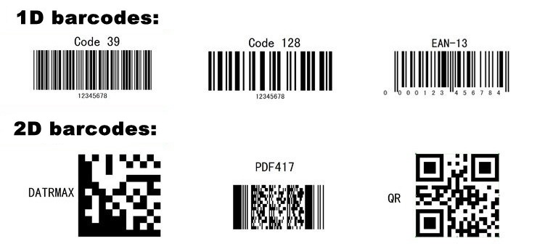
QR Codes (2D Barcode)
A QR code, or Quick Response code, is a two-dimensional matrix barcode that contains information both horizontally and vertically. Developed in Japan in the 1990s, QR codes have become ubiquitous in various applications due to their ability to store a significant amount of data.
QR codes can store upto 3KB of data compared to traditional 1D barcodes which can store upto 85 bytes.
The amount of data a QR code can hold depends on its size and the type of information encoded.

Slide 12
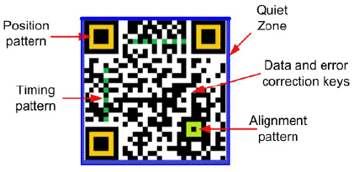
QR Codes (2D Barcode)
Structure:
QR codes consist of black squares arranged on a white square grid. These squares represent encoded data.
The three larger squares in the corners of the QR code allow for quick alignment during scanning.

Slide 13



Segregation by Address
Brooklyn (718-11201)
Queens (929-11355)
Manhattan (212-10002)

Slide 14
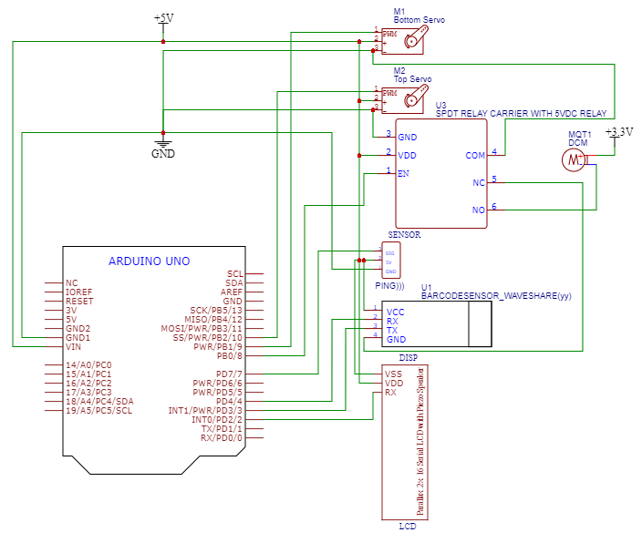
Circuit Schematic

Slide 15
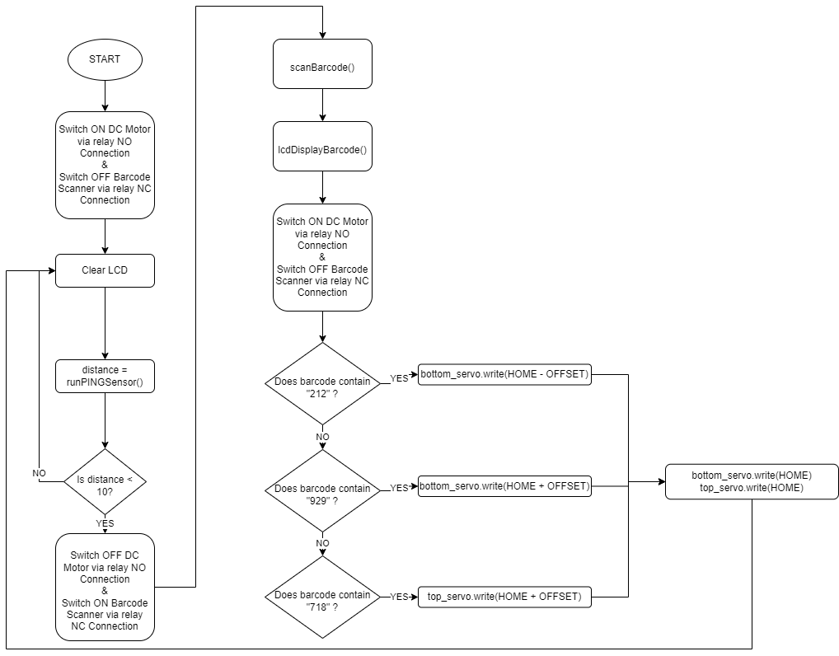
Main Flowchart

Slide 16
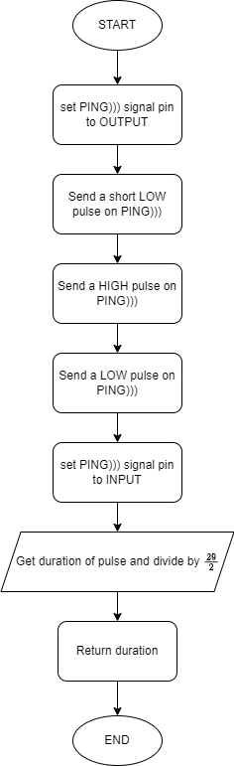
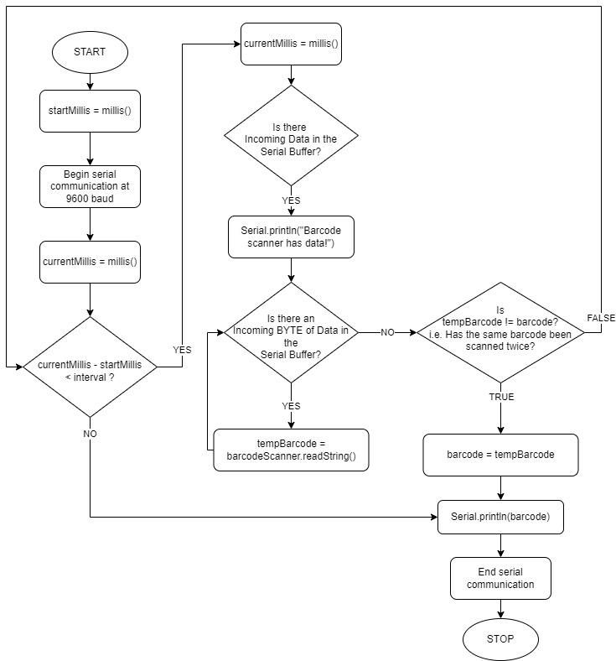
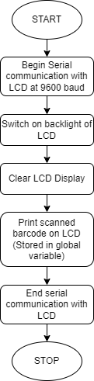
Supporting Flowcharts
Barcode Scanner
LCD Serial
Ultrasonic Sensor

Slide 17
Bill Of Materials
Components | Unit Price (USD) | Quantity | Total Cost (USD) | Source
Conveyor Stand | 0 | 18 | 0 | Makerspace
Conveyor Belt | 0 | 1 | 0 | Scrap
Arduino Uno | 27 | 1 | 25 | Online
Waveshare 1D/ 2D Barcode Scanner | 46 | 1 | 46 | Online
DC Motor | 0 | 1 | 0 | Scrap
Servo Motors | 4 | 2 | 8 | Online
Breadboard Power Supply | 5 | 1 | 5 | Online
LCD | 10 | 1 | 10 | Online
Ultrasonic Sensor PING))) | 23 | 1 | 23 | Online
SRD-05VDC-SL-C Relay | 2 | 1 | 2 | Online
Package Boxes | 0 | 3 | 0 | Scrap
Printed QR Codes | 0.1 | 3 | 0.3 | Printer
Breadboard | 1 | 2 | 2 | Online
Wires and Screws | 0 | 25 | 0 | Makerspace
Total |  |  | 123.3

Slide 18
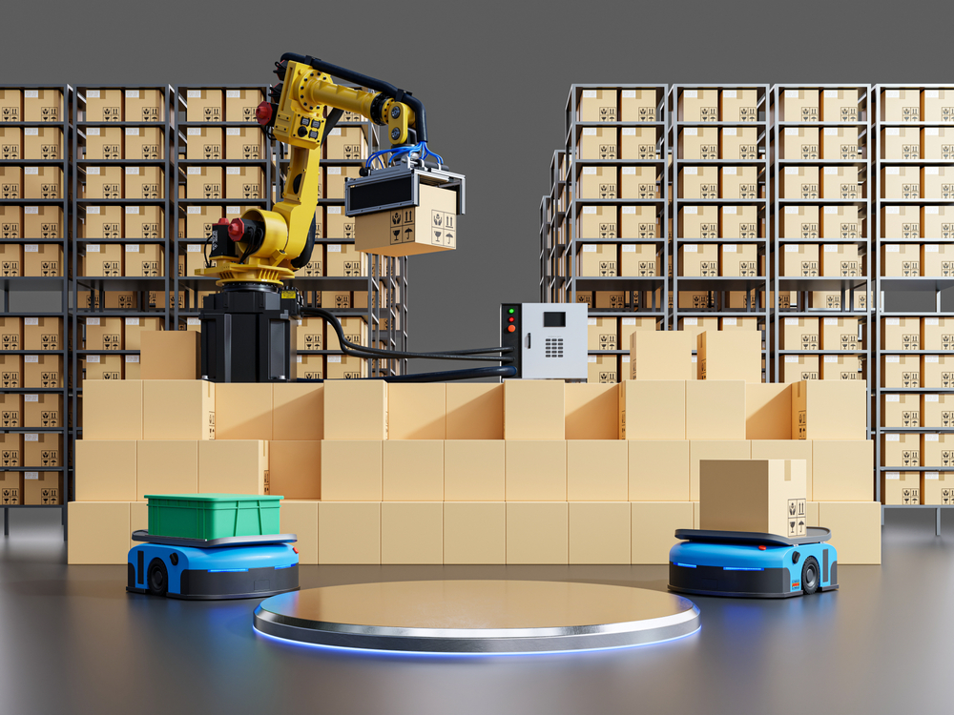
Applications
E-commerce Warehousing:
In e-commerce fulfillment centers, an intelligent package sorter streamlines the sorting and routing of packages, ensuring timely and accurate deliveries.
The system can handle a high volume of packages with different sizes and destinations efficiently without human intervention.
Distribution Centers:
Distribution centers for retail, manufacturing, or any industry can benefit from an intelligent package sorter to automate the sorting process, reducing manual labor and minimizing errors.
Postal Services:
National and international postal services can utilize intelligent package sorters to enhance the speed and accuracy of package sorting, leading to faster and more reliable deliveries.
Notes:
Network of conve

Slide 19
Limitations
Uni-directional Barcode Scanning:
Single barcode scanner is employed which limits the orientation of the package on the conveyor.
Limited number of segregation:
Segregation categories are limited to three.
One-by-one package sorting:
Single package is handled and sorted at a time.
Notes:
Network of conve

Slide 20

Future Enhancements
Multiple Sensors / Mirrors:
Implementing multiple barcode sensors or larger mirrors will help capture the QR code on the package if it is printed on any side but the bottom..
Multiple segregation categories:
Tuning the tilt-table or providing another mechanism can allow separating packages to multiple locations.
Multiple package sorting:
Powerful processor will allow to parallel process multiple packages.

Slide 21


